Slide 1
“Game Box ‘’
Featuring: Ping Pong and Car Game
ELEC5620M Group 19

Slide 2
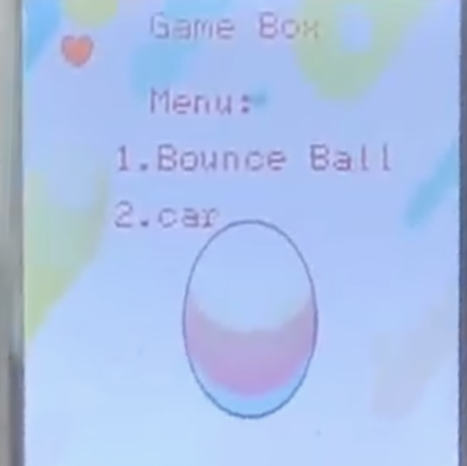
Introduction
“Game box”
Ping-Pong Game
Car Racing Game
Notes:
Our project showcases a versatile game box featuring a Ping-Pong Game and a Car Racing Game, developed using Arm Development Studio and the DE1-SoC Kit with an LCD display for enhanced visuals. The DE1-SoC, with its Altera Cyclone V FPGA and ARM Cortex-A9 processor, efficiently handles real-time processing, graphics, input, and game logic to create an engaging user experience.

Slide 3
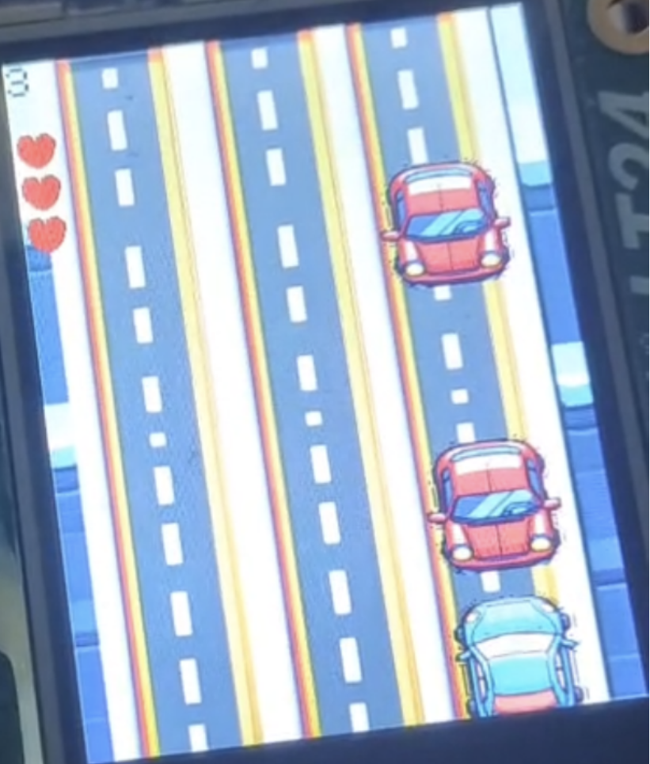
Car Racing Game
Avoidance
Hearts (lives)
Score
Detection of Collision
Real-Time
Press and move
Notes:
Avoid oncoming vehicles by moving left with key1 and right with key0.
Two vehicles appear on the screen at a time. The top-left hearts represent lives, and the score indicates the number of avoided vehicles.
The player has three lives, with each collision deducting one. The game ends when all lives are lost.
This project highlights the DE1-SoC's capabilities in real-time gaming applications, using optimized coding techniques for efficient performance.

Slide 4
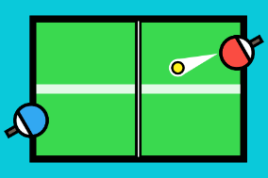
Ping-Pong Game
Collision
AI against
Play sound
Notes:
The start screen menu allows navigation to the Ping-Pong game by pressing key1.
Press key1 again to start the game. Control the paddle with key0 and key1 to catch the ball.
The AI-controlled paddle at the bottom moves automatically. Scores are displayed on the left for both players.
The game ends when a player scores 11 points, displaying the result on the seven-segment display. Press key3 to return to the main menu.

Slide 5
LCD Driver
Proper LCD Initialization
Key Functions: LT24_drawPixel and LT24_copyFrameBuffer
Two Drawing Methods:
Using frameBuffer for full-screen updates
Direct pixel manipulation with drawPixel
Drawing Operations: Text, Lines, Rectangles, Circles, and Images
Optimizing Background Rendering
Notes:
“Proper LCD initialization is crucial for correct display operations.
We used the LT24_drawPixel and LT24_copyFrameBuffer functions from the DE1SoC_LT24 library for drawing images, graphics, and text.We implemented two main techniques for LCD drawing. The first method uses a frameBuffer to represent the entire screen, allowing efficient full-screen updates. The second method involves direct pixel manipulation with drawPixel, ideal for drawing text, lines, rectangles, circles, and simple graphics.
This approach is useful for small, frequent updates
.To optimize performance, background rendering is done only during initialization, reducing processing time during gameplay and ensuring smooth performance.

Slide 6

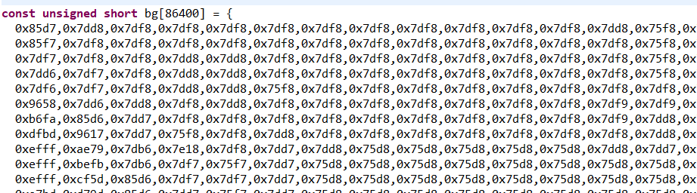
Bitmap Processing
Introduction to converting image files to bitmap format
Tool used: Image Converter 565
Website: http://www.rinkydinkelectronics.com/t_imageconverter565.php
Notes:
The steps to convert image files to bitmap format are as follows:
Prepare the image files you want to convert. Then, upload these image files to the conversion tool. The tool will convert the images into 565 format bitmaps and generate the corresponding C language array code.

Slide 7
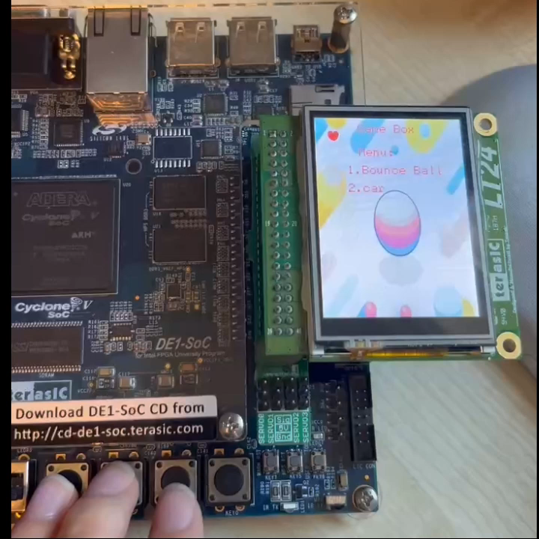
Game - Car
Interrupt-driven input handling
Efficient car movement and collision detection
Optimized rendering techniques
Selective image updates
Notes:
To handle car movements, we used interrupt-driven input detection, allowing the game to respond immediately to key presses and ensure accurate player input capture.
We implemented efficient car movement where the player’s car switches lanes based on input, while other cars move forward automatically. An anti-overlapping mechanism adjusts car positions to prevent overlap.
Collision detection is crucial. We monitor car positions to detect collisions. When a collision occurs, the player’s life count decreases, and the game state updates. A cooldown period prevents continuous detection.
Background rendering is performed only during initialization to reduce processing time.
When updating car positions, we use the reback function to overlay the previous position with the background image, avoiding full-screen updates and reducing iterations.

Slide 8
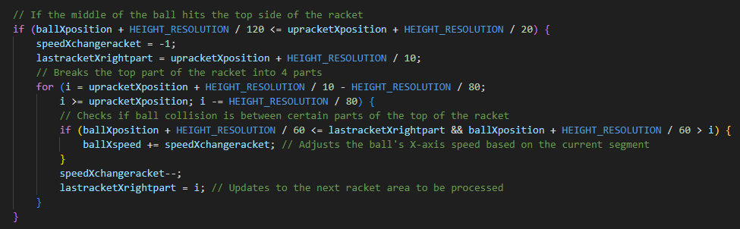
Collision For Ping-Pong Game
The ball's reflection angle is modified based on which part of the racket it hits.
Notes:
CollisionFirst determine whether the ball hits the racket. Next, I simulated different reflection angles by dividing the racket into 4 parts and adjusting the speed of the ball when it landed on the different parts. This provides a variety of ball reflections, making the game more realistic and interesting.

Slide 9
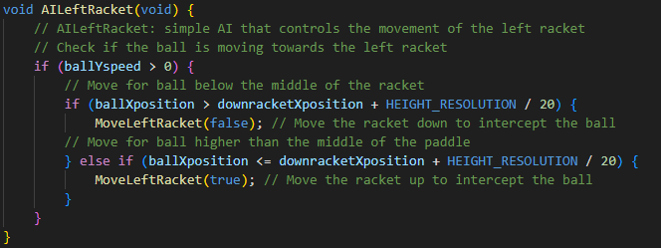
AI Against For Ping-Pong Game
Check the Direction of the Ball: ballXspeed
Determine the Ball's Position: ballYposition and RacketYposition
Execute the Racket Movement
Notes:
AI AgainstBecause this game is not a multiplayer game but a single player game, the other racket is controlled by a machine. This is achieved here by calling the AI Against function. His logic is to first detect ballXspeed to determine whether the ball is moving toward the racket, then compare the Yposition of the ball and the racket to determine whether the ball is above or below the racket, and finally move the racket.

Slide 10
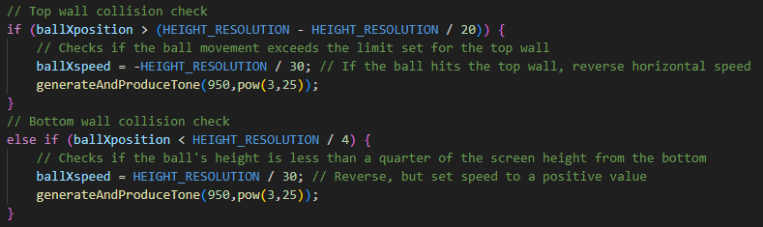
Play Sound For Ping-Pong Game
The audio function is called, and a sound will be emitted once a collision occurs.
Notes:
Play soundThe next thing I want to talk about is play sound. After completing the basic game, I hope to improve the gameplay and entertainment by adding sounds to the game. The content of audio has been studied in unit 3.1 of the course. So I called the audio function, which makes a sound every time a collision occurs, making the game more fun.

Slide 11
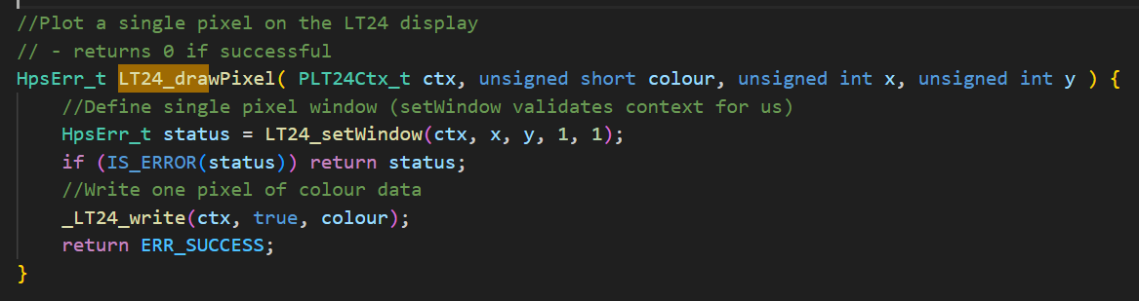
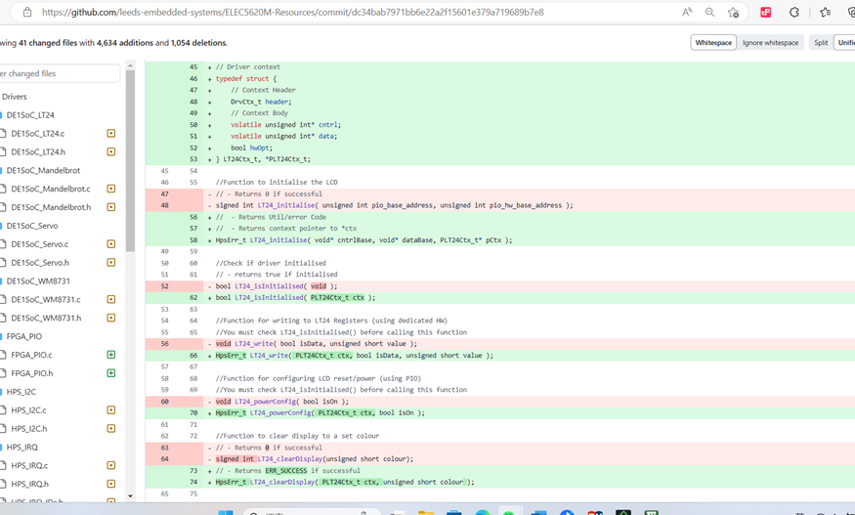
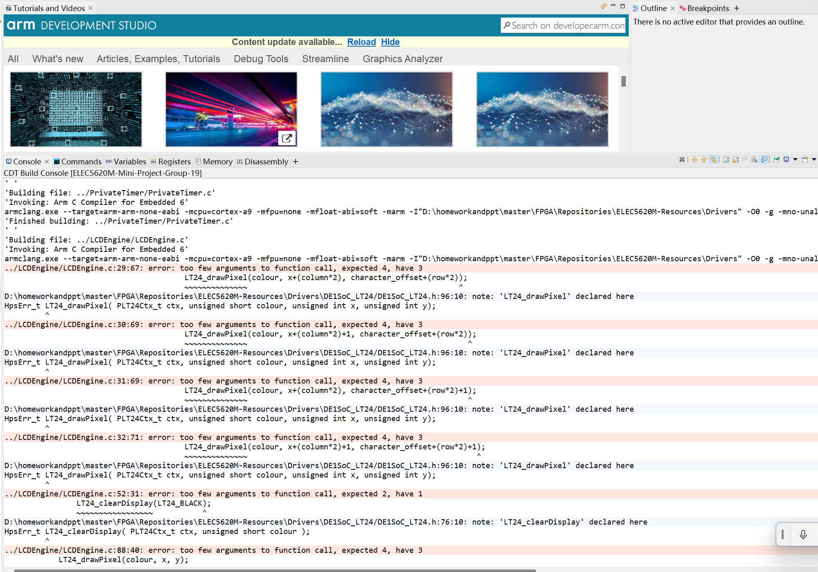
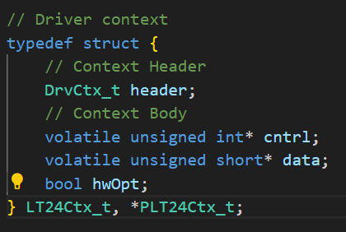
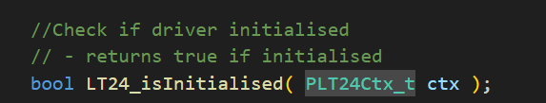
Debugging With LT24
Notes:
Next, I will explain the code integration and the debug section. First of all, during the process of adjusting the pingpong code to the LCD code, due to the incorrect number of parameters in the LT24, there are many errors that are incorrectly caused by the related driver code update (as shown in the figure below). In the analysis and discussion found in this year‘s update, the LT24 update is mainly to add the context of the data structure LT24CTX_T (as follows). The purpose is to put the LT24 control status and data in the structure. Therefore, the entire LT24 driver can be achieved. More fluent and clear！

Slide 12
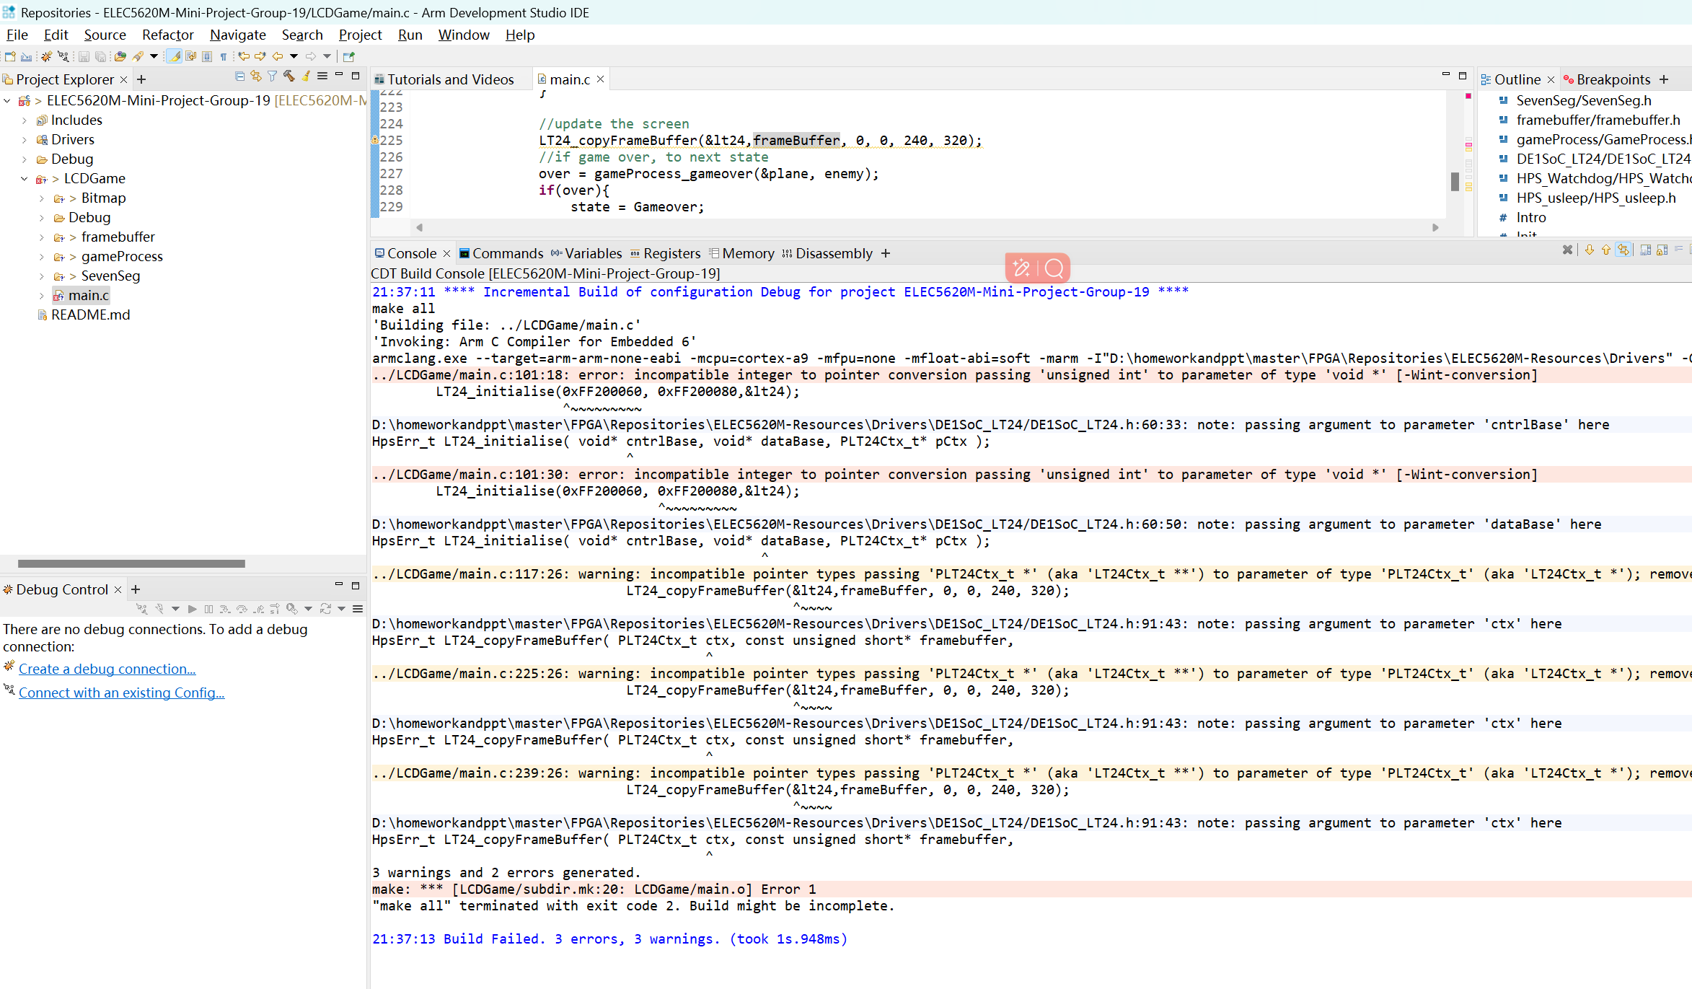
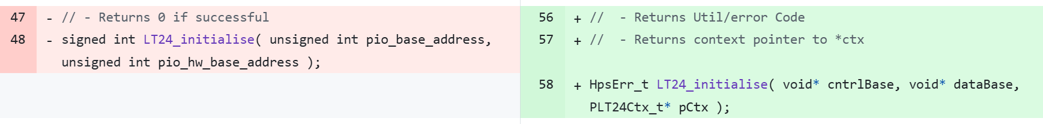
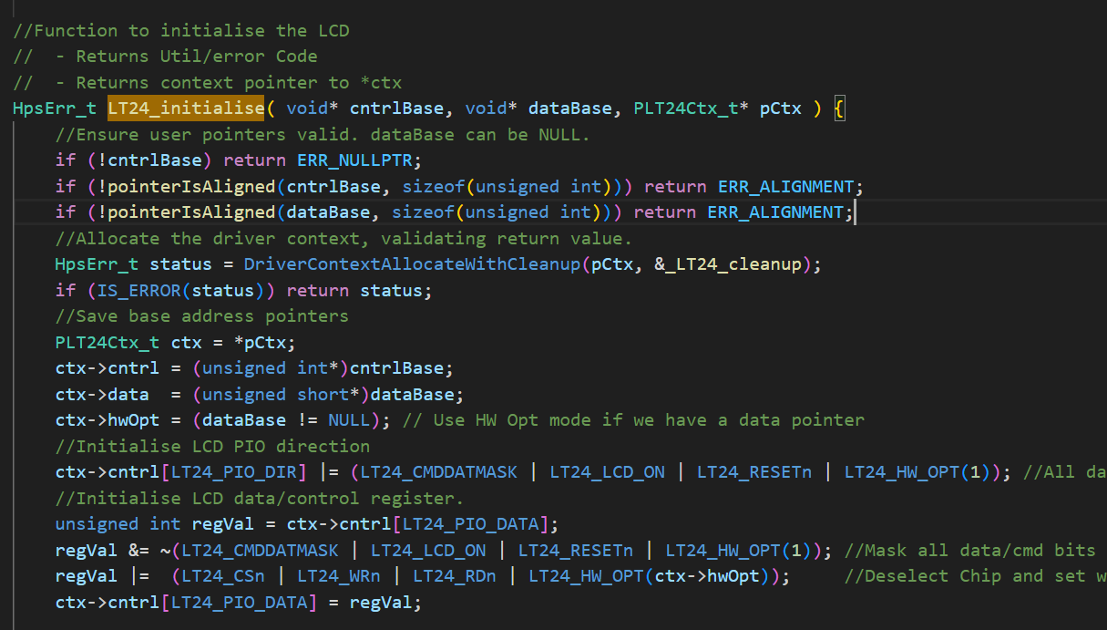
Debugging With LT24
Notes:
It was also discovered while porting that you cannot simply pass the address directly as a parameter, but rather you have to pass it with a pointer that represents the address so that you can accurately use the LT24's display driver

Slide 13
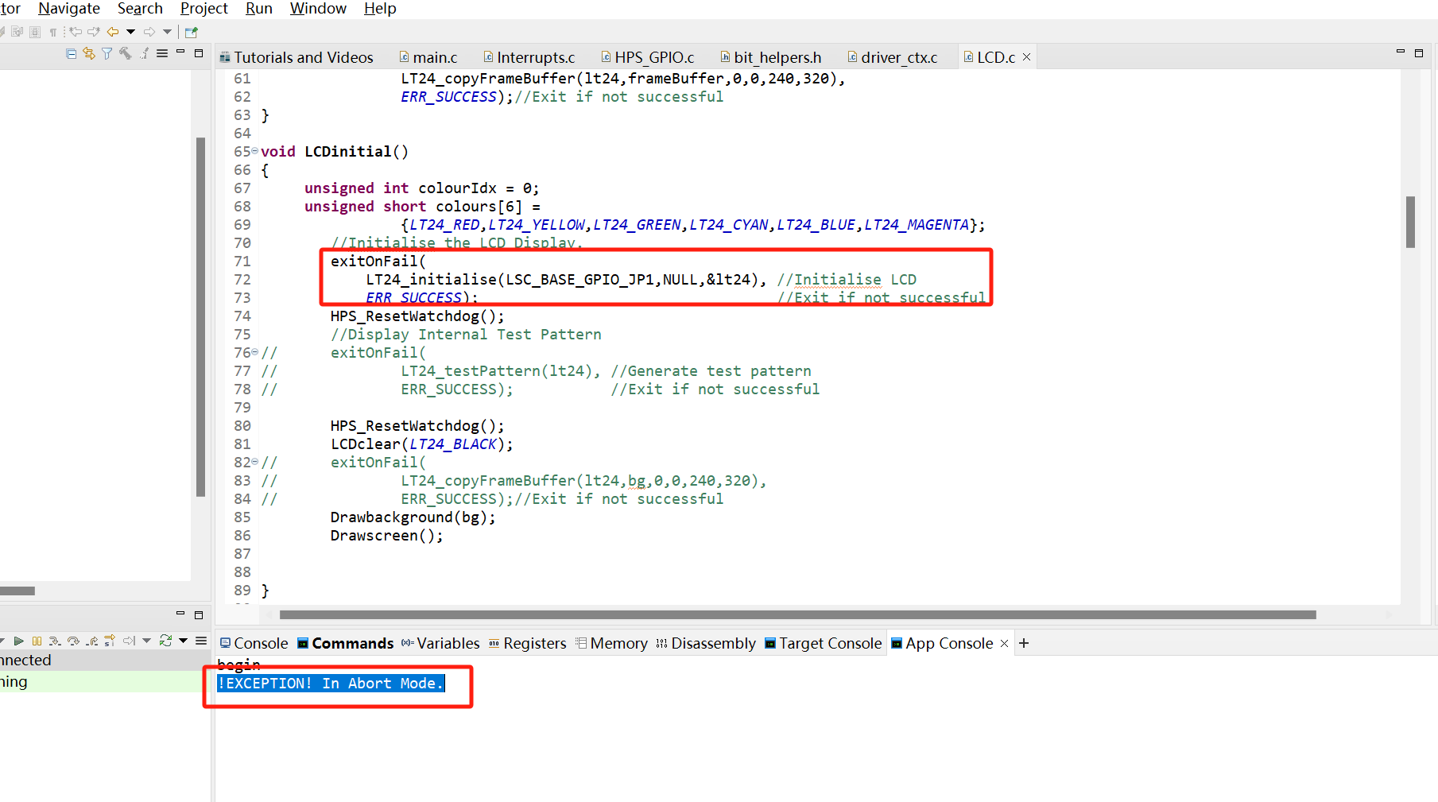
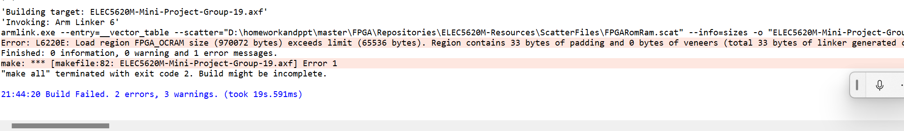
Debugging With LT24
Notes:
When using the LT24 driver for drawing, when we create an array larger than 65536 bytes, it will trigger an error message causing the compilation to be unsuccessful, only to find out that we need to change the FPGARomRam.scat to DDRRomRam.scat, so that we can store the picture in the DDRRom instead of only 65536 bytes in the Rom.
When debugging the interrupt code and adapting it to the pingpong game, there is often a problem with the output of !EXCEPTION! In Abort Mode. Later on, after reviewing the information, I found that there was a wild pointer, which led to an error caused by passing a wild pointer into the function when initialising the LCD.

Slide 14
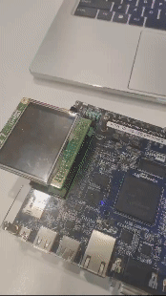
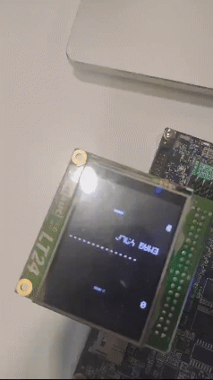
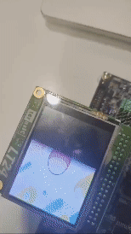
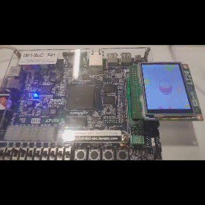
Hardware Testing for Ping-Pong Game
Notes:
After dealing with the problem of mismatched parameter numbers caused by the update of LT24's driver, we compiled and burned the code into the development board, we could see that we successfully entered the cover and entered the game, but the cover did not disappear with the start of the game and the pingpong ball kept blackening the background in the process of movement. Later, we learnt that the student in charge of the pingpong game had set the background to black by default, so that every time the paddle and the ball moved, the previous area would be blacked out, so we chose to change the background back to black
After fixing the background, we noticed that the movement of the ball also blacked out the text (as shown in the video below), so we chose to remove the text.
After dealing with the above problem, I found another problem with the scoreboard displaying abnormally, and after careful analysis, I found that it was the scoreboard changing without effectively clearing the previous number.
After solving the above problems, I found that I can finally play the game normally, the next step is to add the corresponding background image and adapt the game2

Slide 15
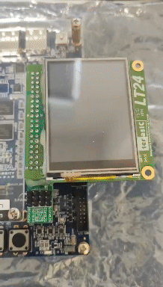
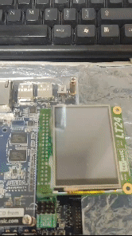
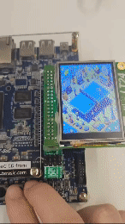
Hardware Testing for Game Box
Notes:
After merging the game2 code and adding the new pingpong game cover, the LCD code was also updated, but since the LCD code puts all the displays in the framebuffer, it slows down the game, as shown in the following video:
After informing the relevant LCD students to modify the code, the problem was successfully solved, the game speed back to normal, basically debugging is complete, but the game button due to interruptions can not be recognised as a long time to press the state, which leads to the ping-pong paddle can only be moved one by one press. The following video shows: After processing the interrupt key detection and ping pong paddle key detection separately, the continuous movement of the ping pong paddle was finally achieved and the game failure screen was successfully displayed as shown in the video below:
After processing the interrupt key detection and ping pong paddle key detection separately, the continuous movement of the ping pong paddle was finally achieved and the game failure screen was successfully displayed as shown in the video below

Slide 16
Conclusion
The aim of the project was achieved.
Optimisation technique used.
Created a working Game Box
Ping Pong Game
Car Game
Project shows that complex and real time games came be achieved.
Opens the way for future innovations.

Slide 17
REFERENCES
ELEC5620 - UNIT 1 - DE1SoC_SevenSeg.c
ELEC5620 - UNIT 2 - NonBlockingTimer.c
ELEC5620 - UNIT 3 - Tone Generator
GitHub project evanso931/Pong-Embedded-C for game1 and LCD
ELEC5620 - UNIT A - 2-A-Interrupts

